Slide 1
Entertainer Data Analysis

Slide 2
Introduction:
An entertainer is a person whose job or goal is to perform for the amusement of others. If you're an entertainer, you might learn how to tap dance and take singing lessons. If you make your living as a comedian, you're an entertainer. You're also an entertainer if you're a dancer, singer, actor, or puppeteer.
Entertainer data analysis involves examining various aspects of entertainers, such as their career trajectories, audience demographics, popularity trends, financial earnings, and social media presence.
This type of analysis can provide valuable insights into the entertainment industry, helping stakeholders make informed decisions about marketing, content creation, and talent management.

Slide 3
Details of data:
Entertainer – basic info
Entertainer – breakthrough info Entertainer – Final data
Entertainer – last work info
Combined the above three datasets to single dataset as Entertainer – Final Data. And also created the new column ‘image’ of Entertainer.

Slide 4
Main KPI’S:
Overview : This is the overall analysis of each Entertainer
Entertainer analysis : This analysis focuses on understanding the demographic characteristics and career progression of entertainer in the dataset
Breakthrough analysis : This Analysis concentrates on understanding the significant breakthrough achievements of the entertainer.
Award analysis : This analysis focuses on examining the awards and accolades received by the entertainer.

Slide 5
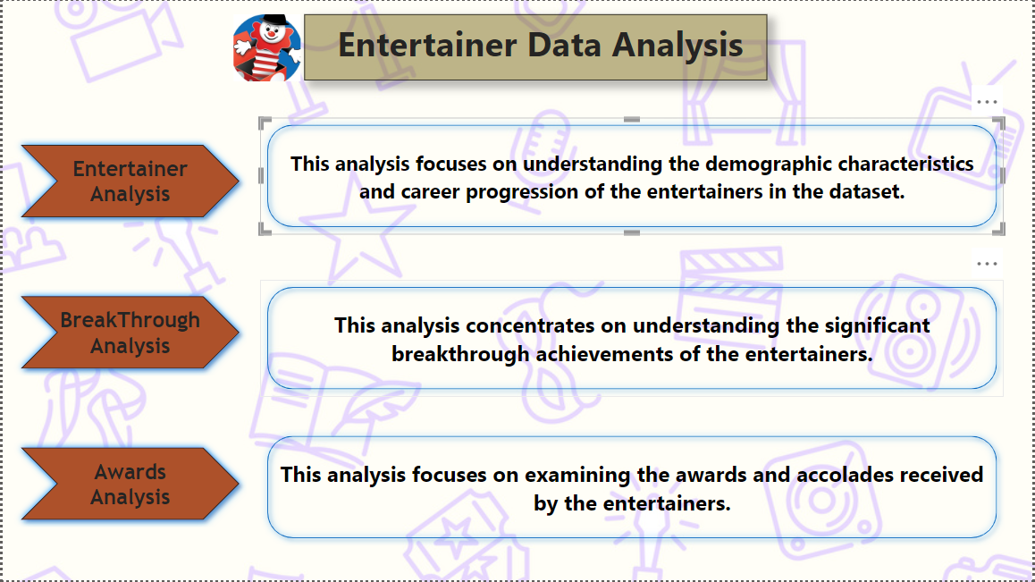
My dashboard:

Slide 6
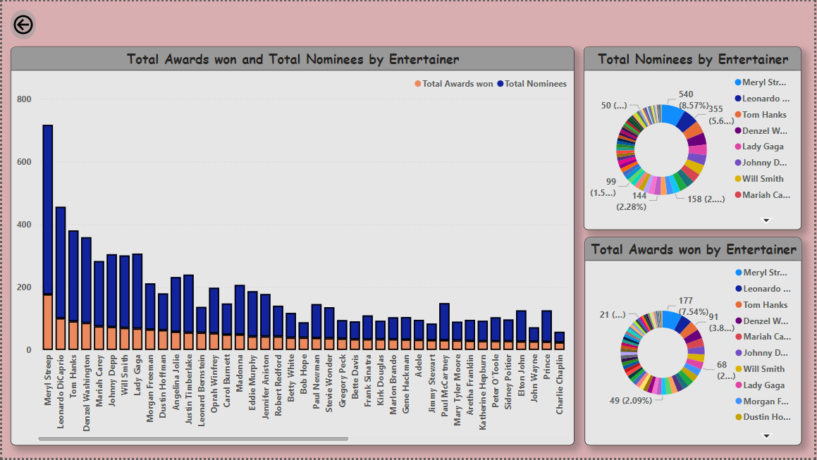
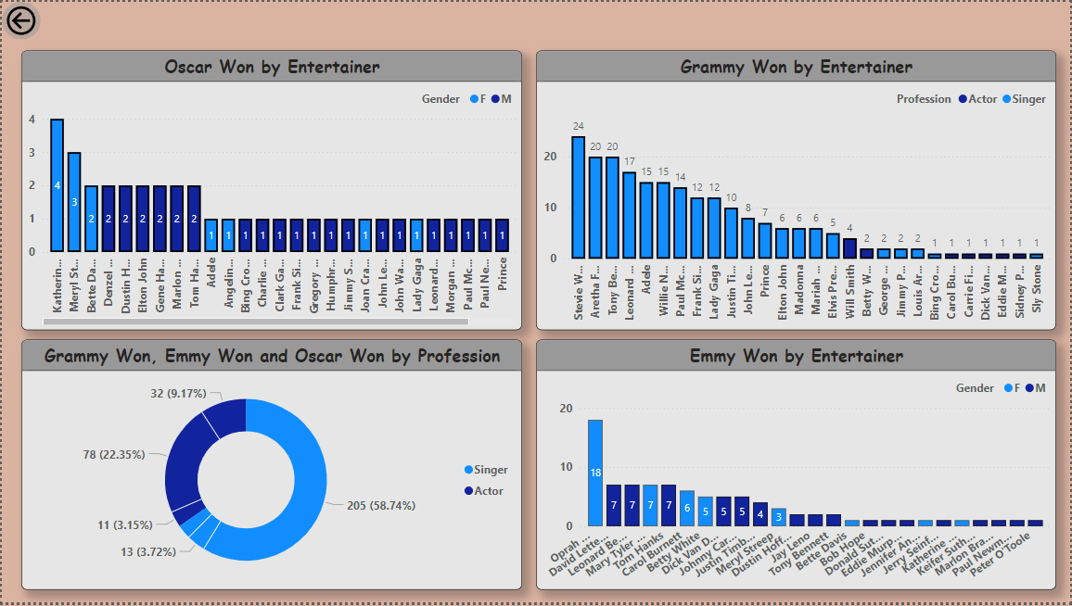
My design:

Slide 7
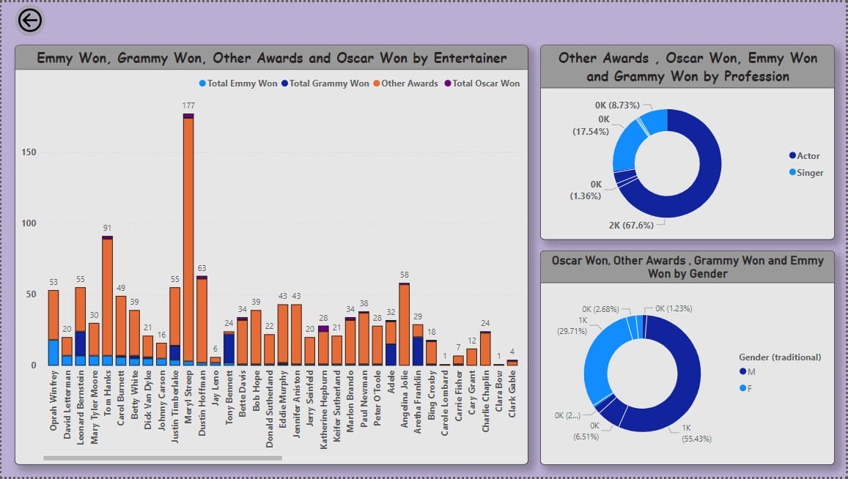
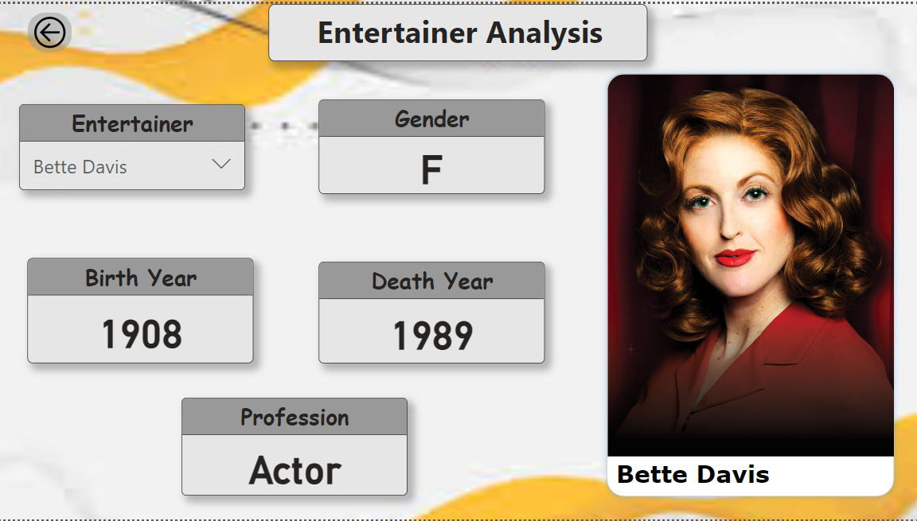

Slide 8
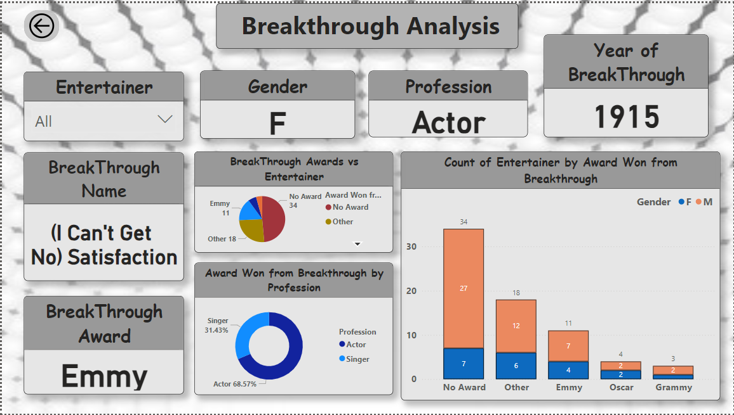
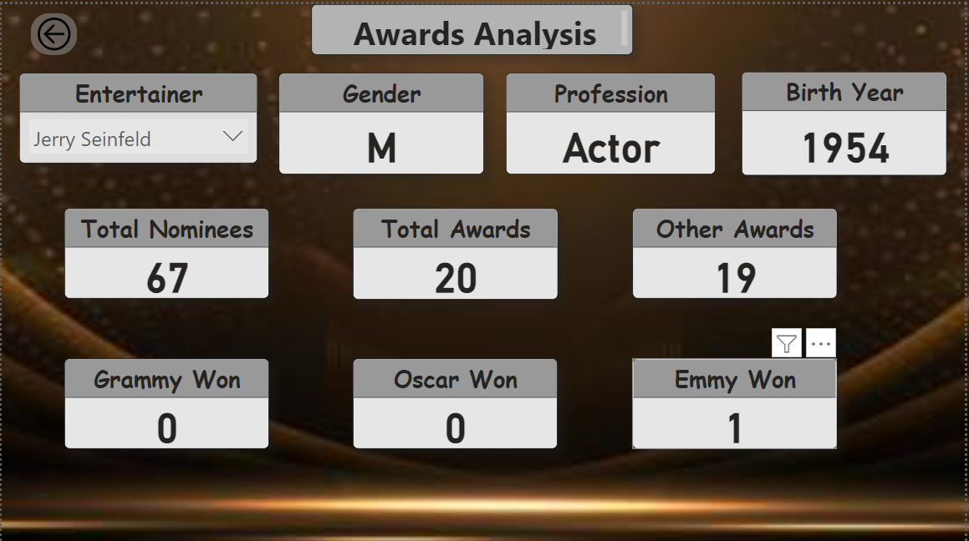

Slide 9
Thank you

